Slide 1
The Art of Debugging: Mastering Software Problem-Solving

Slide 2

Content
1. Introduction to Debugging
2. Debugging Techniques
3. Debugging in Practice

Slide 3

Introduction to Debugging
Section 1

Slide 4




Understanding Debugging
Definition of Debugging
Debugging is the systematic process of identifying and resolving issues within software code.
Importance in Software Development
Emphasize how debugging is crucial for creating reliable and efficient software.
Common Misconceptions
Clarify common misunderstandings about debugging to set the stage for deeper learning.
01
02
03

Slide 5
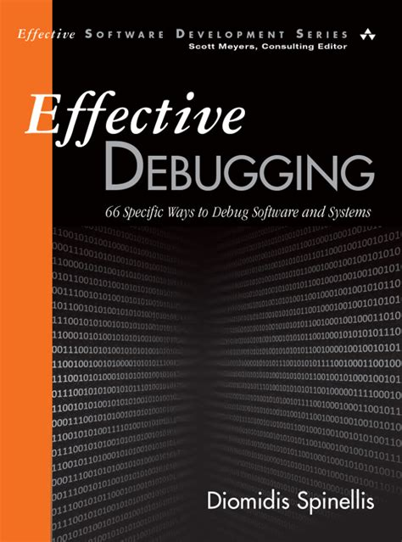

The Debugging Mindset
Patience and Perseverance
Cultivate the necessary patience and a methodical approach to problem-solving.
Strategic Thinking
Encourage adopting a strategic mindset to tackle bugs effectively.
Learning from Mistakes
Highlight how each debugging session is an opportunity to learn and improve coding skills.

Slide 6
Types of Software Bugs
Syntax Errors
Explain simple mistakes in code that prevent programs from running.
Logical Errors
Discuss errors that occur when the program runs but produces incorrect results.
Runtime Errors
Describe issues that cause a program to crash or behave unexpectedly during execution.
01
02
03

Slide 7
Debugging Techniques
Section 2

Slide 8





Systematic Debugging Approach
Isolating the Bug
Techniques for narrowing down the source of the problem within the code.
Creating Reproducible Tests
The importance of being able to consistently reproduce a bug to understand it better.
Using Version Control
How version control systems can aid in tracking changes and identifying when bugs were introduced.
01
02
03

Slide 9


Debugging Tools and Resources
Integrated Development Environments (IDEs)
Show how IDEs can simplify the debugging process with built-in tools.
Breakpoints and Stepping
Teach the use of breakpoints and step-by-step execution to inspect program behavior.
Viewing and Analyzing Data
Demonstrate how to inspect variables and program state to find clues about bugs.

Slide 10















Slide 11
Advanced Debugging Strategies
Memory Leak Detection
Discuss tools and techniques for identifying and fixing memory leaks.
Performance Profiling
Introduce profiling tools to find efficiency issues and bottlenecks in code.
Thread and Concurrency Issues
Explain how to approach debugging in multi-threaded and concurrent programming environments.
01
02
03

Slide 12
Thank You

